Slide 1
Shrink Forecasting Using Deep Learning Methodologies
May Update 2021

Slide 2
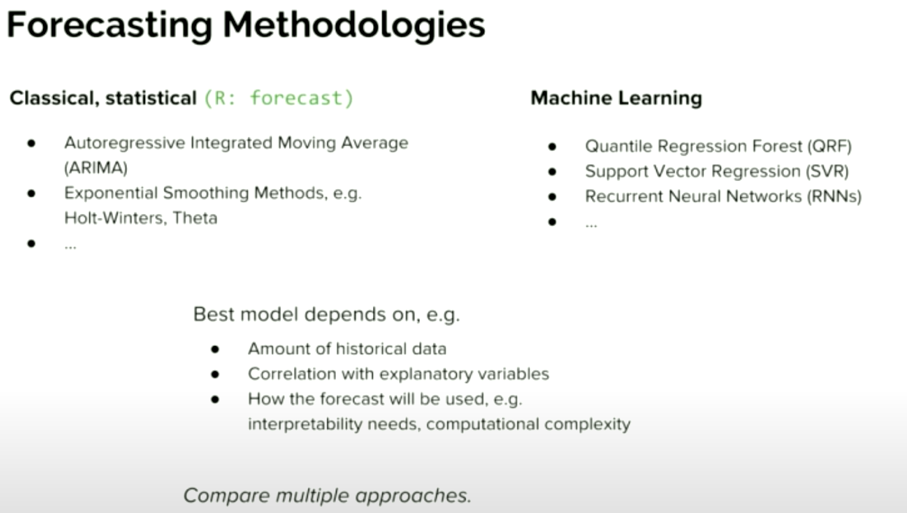
Appendix:

Slide 3
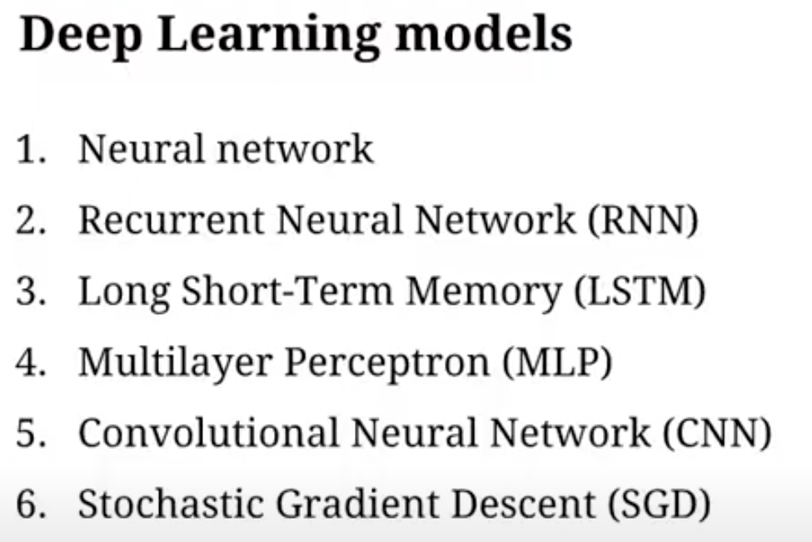

Slide 4
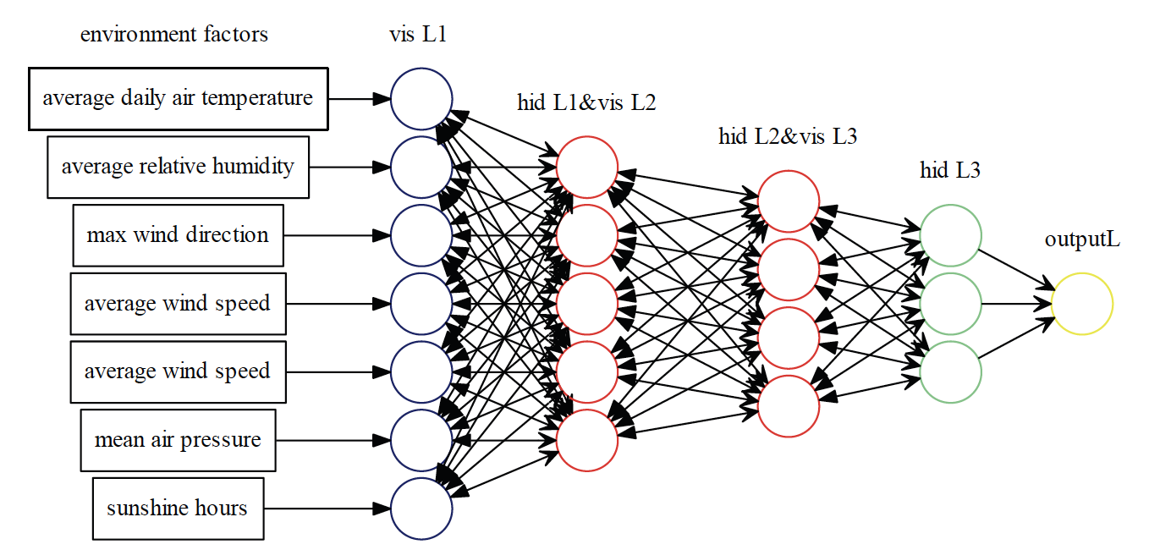
Recommended Approach
Identifying the most important variables to forecast
Solve Time Series Problem utilizing deep learning
Forecast out by week 13-24 weeks out
Shrink Factors
Economic Indicators
Shrink Rate
FET, LU, Location
HR, Terms, Tenure
Competition
CS/RNN/BOPIS
Clearance, Turns
Notes:
Average Tenure, Quick Term, Average Wage, PT Ratio,

Slide 5
Update
DATA
  Stores Dropping
    1103, 1573, 1585, 1654, 1657, 1658, 1703, 1790, 1908, 1951, 1990, 2123, 2145, 2503, 2558, 2617, 2657, 2672, 2686 Roughly ~ 912 rows of data
EDA
  Shrink Over time vs Region (look at regional differences at Store level)
  Weekly Sales vs Region
  Shrink Rate Over Time
  Sales vs Shrink Rate (defacto status quo)
  Sales vs Shrink $
Feature Importance
  Condensing RSN columns (open to trial, given low values)
  BOPIS (Cancelled %, drop counts)
Economic Indicators
  Unemployment
  Building Permits
Modeling
  LSTNet
    Multivate Time Series - CNN - RNN - FCN
  RNN
  CNN - LSTM
First Output - Tuesday June 1st

